Slide 1
PHY 202- Electric Circuits and Electronics

Slide 2
PHY 202- Electric Circuits and Electronics
Lecturers:
Dr. Adeleye
Dr. Oyelade
Room 16, Postgraduate Block, laradele04@gmail.com
Course contents
Introduction to semiconductors, the pn-junction, Field effect transistors, Bipolar junction transistors, Characteristics & equivalent circuits, amplifiers, Feedback, Oscillators

Slide 3
What You Learnt
Atomic Structure
An atom comprises the nucleus and electrons arranged in shells (allowed orbits) around the nucleus.
The number of electrons in the shells are quite unique to the atoms of the particular element/material.
The electrons in a single atom have discrete energy levels.
Actual materials contain innumerable number of atoms packed together and their energy levels overlap to form bands.
There will be bands comprising allowable energy levels very close to one another, and other forbidden energy bands.

Slide 4
What You Learnt
The lowest available energy band is called the valence band (VB) & the next available energy band is the conduction band (CB).
The band picture enables us to distinguish metals, insulators, and semiconductors.
The difference in energy between the valence band and the conduction band is called an energy gap or band gap. This is the amount of energy that a valence electron must have in order to jump from the valence band to the conduction band.
CB
CB
CB
Wide band gap
Narrow b/gap
VB
VB
VB
(a) metal
(b) semiconductor
(c) insulator

Slide 5
What You Learnt
Electrons in the VB can acquire sufficient energy (e.g., from sunlight) to surmount the energy gap to the CB. It leaves behind a vacancy or hole.
Electrons adjacent to this hole can move into it creating a new hole. In the VB therefore there is a movement of holes, and the CB there is motion of the electrons.
In semiconductors current flow is due to motion of both electrons and holes.

Slide 6
Crystals
Semiconductor atoms have four valence electrons. Silicon is the most widely used semiconductive material.
Examples of semiconductors: silicon and germanium.
Silicon is used in diodes, transistors, integrated circuits, and other semiconductor devices.
Semiconductor atoms bond together in a symmetrical pattern to form a solid material called a crystal.
The bonds that hold a crystal together are called covalent bonds.

Slide 7
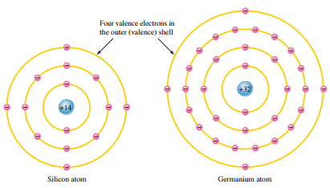
Silicon and germanium atoms
The valence electrons in Ge are in the fourth shell while those in Si are in the third shell, closer to the nucleus.
This means that the Ge valence electrons are at higher energy levels than those in Si requires a smaller amount of energy to escape from the atom.
This property makes Ge more unstable at high temperatures and results in excessive reverse current. This is why silicon is a more widely used semiconductive material

Slide 8
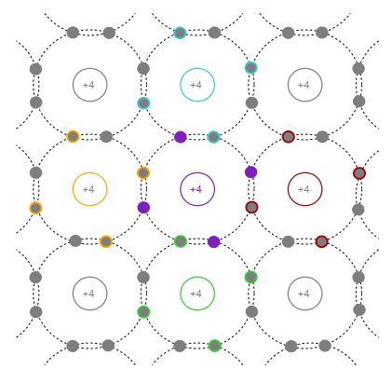
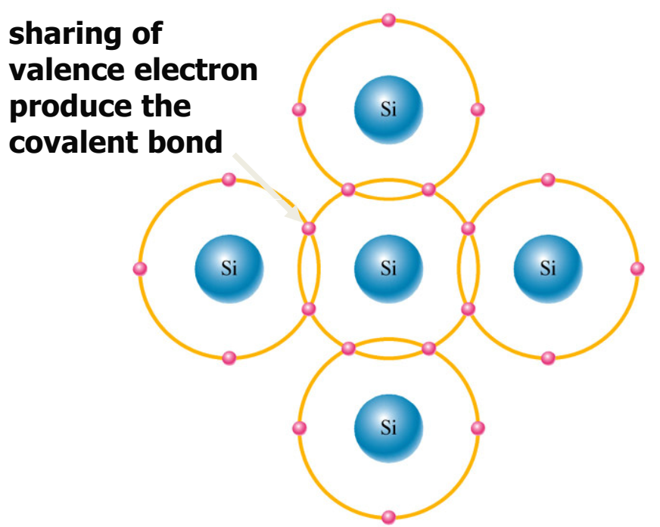
Covalent Bonding A chemical bond that involves the sharing of electron pairs between atoms
The centre atom shares an electron with each of the four surrounding atoms creating a covalent bond with each. The surrounding atoms are in turn bonded to other atoms, and so on.
Silicon crystal covalent bonding

Slide 9
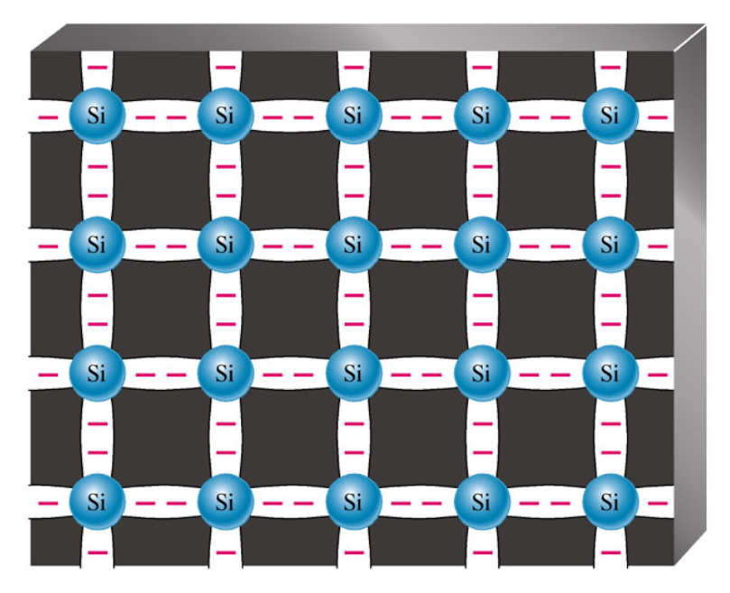
Covalent Bonding
Covalent bonding in an intrinsic or pure silicon crystal. An intrinsic crystal has no impurities.
Covalent bond in a 3-D silicon crystal
The atom are held together forming a solid substrate.
The atoms are all electrically stable, because their valence shells are complete.
The complete valence shells cause the silicon to act as an insulator-intrinsic (pure) silicon. This makes the pure silicon a very poor conductor.

Slide 10
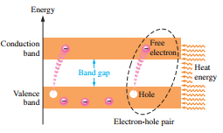
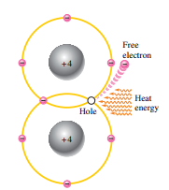
Conduction Electrons and Holes When a voltage is applied across the semiconductor, the thermally produced free electrons move toward the positive end and form the current. This is one type of current and is called electron current. Another type of current is hole current. This occurs as valence electrons move from hole to hole creating, in effect, a movement of holes in the opposite direction
Energy diagram
Bonding diagram

Slide 11
Conduction in Semiconductor
A pure (intrinsic) silicon crystal that is unexcited (no external energy such as heat) has no electron in the conduction band. This occurs only at a temperature of absolute 0 Kelvin (-273ºC).
When heat is applied to an electron, it jumps to the conduction band, a vacancy is left in the valence band, this vacancy is called a hole and the electron is said to be in an excited state.
When a conduction-band electron after a few microseconds of becoming free, losses its energy and falls back into a hole in the valence band, recombination has occurred.
Energy given up by the electron in the form of light and/or heat.
At temperature room, a number of free electrons that are unattached to any atom drift randomly throughout the material. This condition occurs when no voltage is applied across intrinsic (pure) Silicon.

Slide 12
Conduction in Semiconductor
When a voltage is applied across the piece of intrinsic Si, the thermally generated free electrons in the conduction band, which are free to move, are now easily attracted toward the positive end. The movement of free electrons in a semiconductor material is called electron current.
At the same time, there are also an equal number of holes in the valence band created by electrons that jump into the conduction band. Electrons remaining in the valence band are still attached to the atom – not free to move like free electron.
However, valence electron can move into nearby hole – leaving another hole it comes from. Thus, hole has moved from one place to another in the opposite direction. The movement of electrons in a valence band is called hole current.

Slide 13
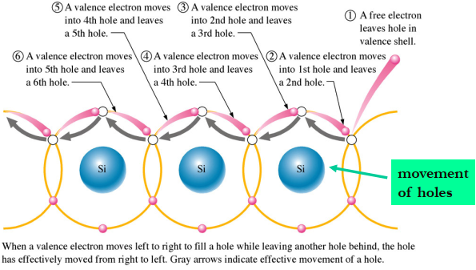
Electrons and Holes Current

Slide 14
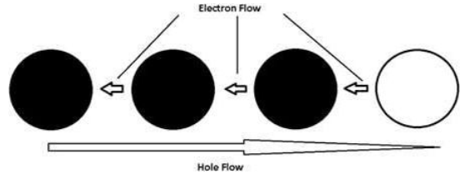
Electron and Hole Current
When electrons move to the empty holes during electron flow, the “movement” of the empty holes is called hole flow.

Slide 15
Doped Materials
Semiconductive materials do not conduct current well and are of limited value in their intrinsic state because of the limited number of free electrons in the conduction band and holes in the valence band.
The properties of the material can be altered by introducing foreign substances or impurities into the crystal to increase its conductivity.
These impurities are known as dopants. A crystal with an added dopant is referred to as an extrinsic semiconductor or doped material. Doping increases the number of current carriers.
The amount of impurity added is generally small, like of one part per million. The dopant may be added through a gaseous diffusion process or ion implantation. The process of adding impurities is called doping.
There are two types of doped semiconductors: N-type material and P-type material. These are the key building blocks for most types of electronic devices.

Slide 16
N-type and P-type Semiconductor Materials
Semiconductive materials do not conduct current well and are of limited value in their intrinsic state because of the limited number of free electrons in the conduction band and holes in the valence band.
Intrinsic silicon (or germanium) must be modified by increasing the number of free electrons or holes to increase its conductivity and make it useful in electronic devices.
This is done by adding impurities to the intrinsic material. The process of adding impurities to a semiconductor is to form an impure is called doping
Two types of extrinsic (impure) semiconductive materials: n-type and p-type. These are the key building blocks for most types of electronic devices.
Doping increases the number of current carriers (electrons or holes)

Slide 17
N-type Material
An N-type semiconductor is formed when pentavalent impurities e.g. arsenic (As), phosphorus (P), bismuth (Bi), and antimony (Sb) are added to Si or Ge through covalent bonds.
the pentavalent impurity creates an extra, or donor electron. This results in an increase of free electrons.
The extra electron becomes a conduction electron because it is not attached to any atom. The number of conduction electrons can be controlled by the number of impurity atoms added.
The number of free electrons is significantly larger than the number of holes in N-type material, electrons in N-type material are referred to as the majority charge carrier (or majority carrier) while holes are referred to as the minority charge carrier (or minority carrier).

Slide 18
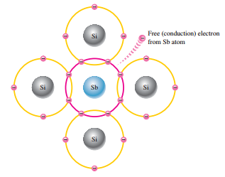
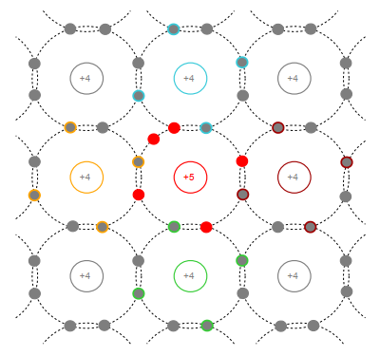
N-type Material
Pentavalent impurity atom in a silicon crystal structure. An antimony (Sb) impurity atom is shown in the center. The extra electron from the Sb atom becomes a free electron.
Crystal with added pentavalent impurity (N-type)

Slide 19
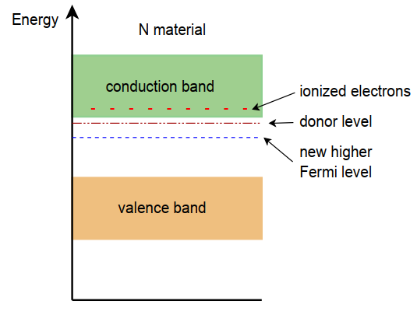
N-type Material
The extra electrons add to the number of filled energy states and, being of higher energy than the valence electrons, push the Fermi level to a higher value.
The donor level is closer to the conduction band and that the Fermi level has been pushed up, away from the valence band and closer to the conduction band.
Energy band diagram of N-type semiconductor

Slide 20
P-type Material
A P-type semiconductor is formed when trivalent impurities such as boron (B), indium (In), and gallium (Ga) are added to Si or Ge through covalent bonds.
A hole is created when each trivalent atom is added. A hole is the location where an electron is lacking. The trivalent impurity can take an electron, so are called acceptor atom.
The number of holes can be controlled by the number of trivalent impurity atoms.
In p-type materials, holes are the majority carries and electrons are the minority carries.
In P-type material, holes out number free electrons. Consequently, holes are referred to as the majority charge carriers while electrons take on the role of minority charge carriers.

Slide 21
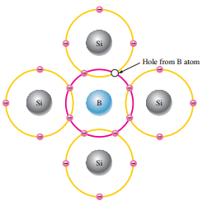
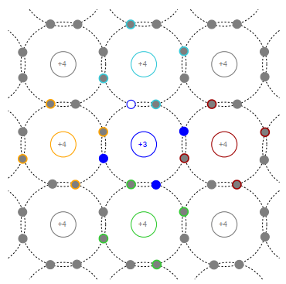
P-type Material
Trivalent impurity atom in a silicon crystal structure. Boron (B) impurity atom is shown in the center. A hole created by this doping process is not accompanied by a conduction (free) electron.
Crystal with added trivalent impurity (P-type).

Slide 22
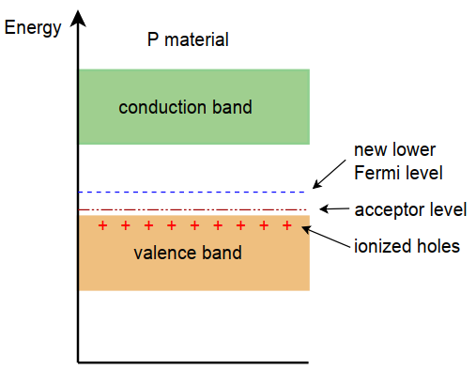
P-type Material
The resulting situation is essentially the reverse of that of the N-type material.
The Fermi level has been pushed down, closer to the valence band.
Energy band diagram of P-type semiconductor

Slide 23
Review Questions 1. Describe the differences between a conductor, an insulator and a semiconductor. 2. Define the terms Fermi level, valence band, conduction band and band gap. 3. Differentiate between a valence electron and free electron, positive and negative ionization, intrinsic and extrinsic crystal.
4. What is meant by the term doping? Describe the semiconductor materials that can be formed through this process. 5. What is the effect of donor and acceptor impurities on the Fermi level?
6. Compare: semiconductor and conductor, silicon and germanium atoms.
Explain electron and hole current.

Slide 24
References
Semiconductor Devices: Theory and Application, by James M. Fiore Version 1.1.2, 2019
Electronic devices by Thomas L. Floyd. Pearson Education Inc. Prentice Hall Publisher, New Jersey, ISBN-13: 978-0-13-254986-8

